Slide 1
Automating PoP Stock Check
Brooks Beckelman, Zack Bilderback, Estevan Gonzales, Dallas Griffin, Sean Kessel, Davis Townsend

Slide 2
Presentation Outline
Introduction
OpenCV
Approach #1: Template Matching
Image Preprocessing
Approach #2: Deep Learning
Notes:
ESTEVAN

Slide 3
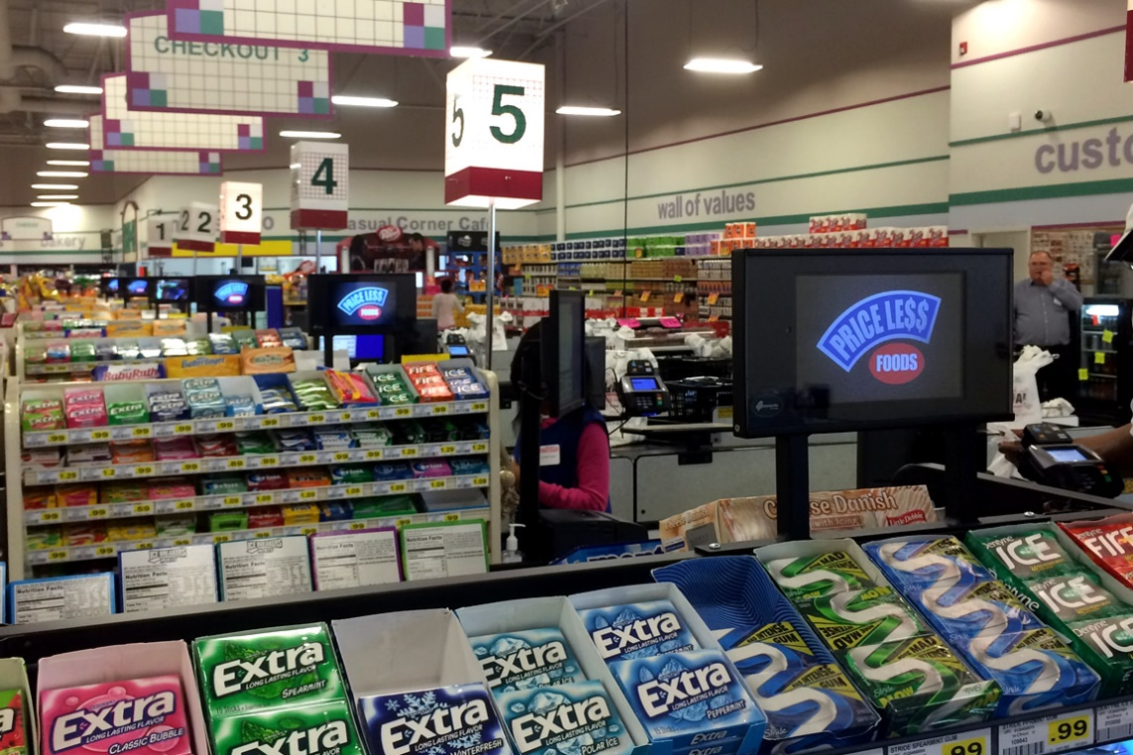
PopSpots
Start-up specializing in digital point-of-purchase (PoP) advertisement systems
Work with grocers and retailers to install tablets in check-out aisles
Sell advertisements (still images and/or videos) in 7-second increments on the marketplace
Offer dynamic ad slots for specific regions or locations that only run and charge when customers are in the check-out aisle
Notes:
ESTEVAN

Slide 4
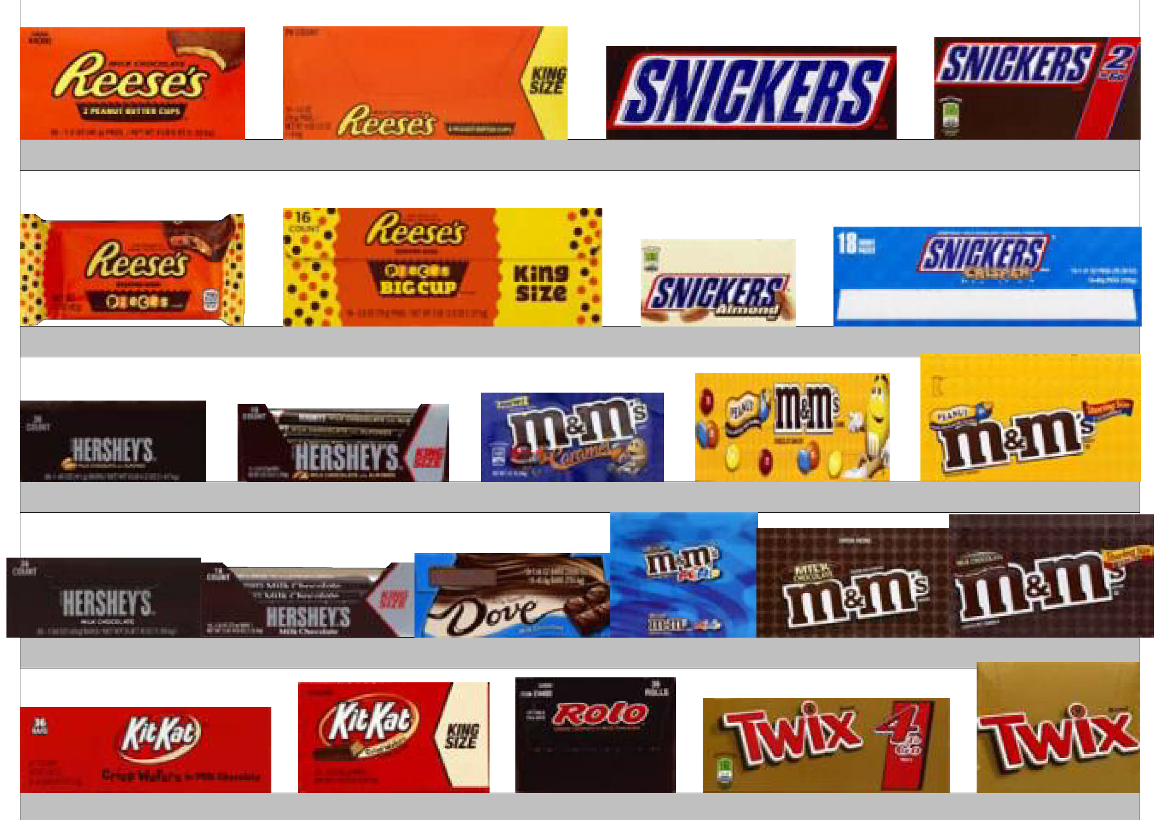
Business Case
PoP rack is a major revenue generator for retailers
Nets on average $24,000 per rack per year
10% ($2,400) of this is lost from out-of-stock product
Retailers face a significant challenge keeping their PoP racks stocked and in compliance with product placement agreements
Stock check service would incur limited costs beyond its development and position well with the company’s long-term strategy of leveraging innovative technology to create value at retailer’s PoP
Notes:
ESTEVAN

Slide 5
Objectives
Primary
Develop automated system that can accurately segment an image of a rack into its component SKUs
Stretch
Refine system to map segment images to their corresponding SKUs (i.e. Snickers, Kit-Kat, etc.)
Future State
Further refine to estimate the stock level of an SKU (i.e. “fully stocked”, “almost out”, “out of stock”) and link with automated (or semi-automated) restock system
Notes:
ESTEVAN

Slide 6
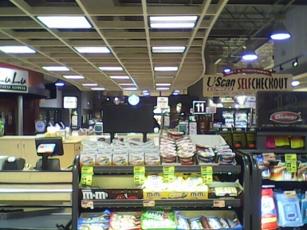
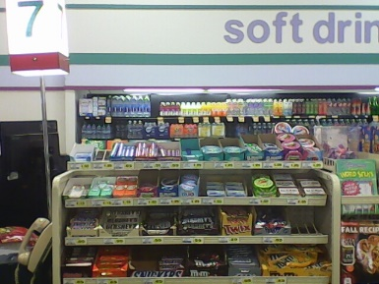
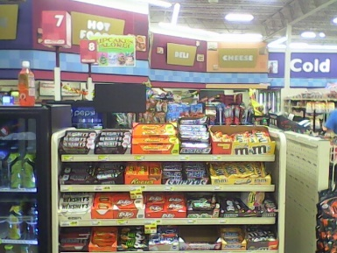
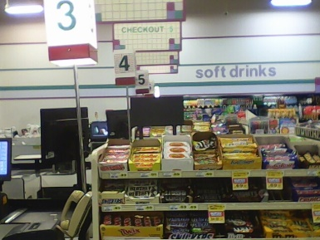
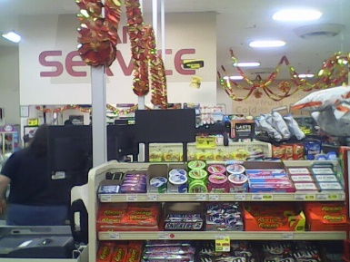
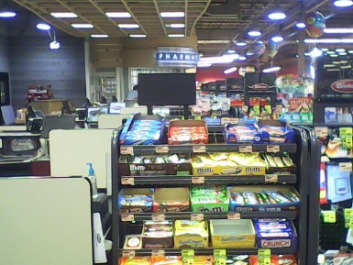
Data Scope
4 images per day of 25 racks at 10 grocery stores taken over 10 business days (~1,000 total images)
~30 SKUs per rack (~30,000 SKUs)
Raw pixels per image: 640 x 480
Pixels in raw dataset: 307,200,000
Training data of ~10 images per unique SKU
Compiled using scraper to pull product images from Bing
Notes:
ESTEVAN

Slide 7
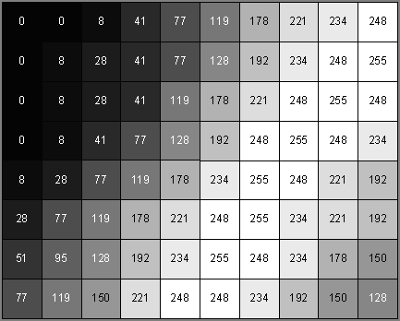
Image Data Structure
Grayscale Image: 2-D array of numbers (intensity values/gray levels)
Gray Levels: 0 (black) to 255 (white)
Each pixel assigned a value
Color Image: Three 2-D arrays of numbers (red, green, blue)
Resolution: number of rows and columns
128 x 128, 256 x 256, etc.
Notes:
BROOKS

Slide 8

OpenCV | Open Source Computer vision software
Library of programming functions mainly aimed at real-time computer vision
More than 2500 optimized algorithms
Includes comprehensive set of both classic and state-of-the-art computer vision and machine learning algorithms
Built to provide a common infrastructure for computer vision applications and to accelerate the use of machine perception in commercial products
Started as Intel research initiative
C++, C, Python, and Java interfaces
Supports Windows, Linux, Mac OS, iOS, and Android
Notes:
BROOKS

Slide 9
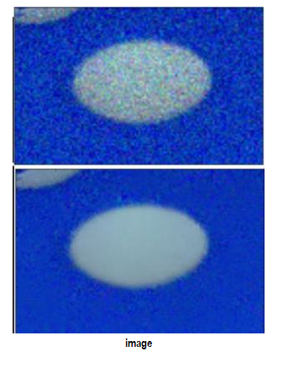
Image preprocessing | image denoising
Non-Local Means Denoising:
Take small window around a pixel
Search for similar windows in the image
Average all the windows
Replace the pixel with result
Smooths the image, but detail is lost
Note: Interestingly, it didn’t seem to make much of a difference, even when trying to tune the denoising parameters
May be due to low res nature of our images
Notes:
BROOKS

Slide 10
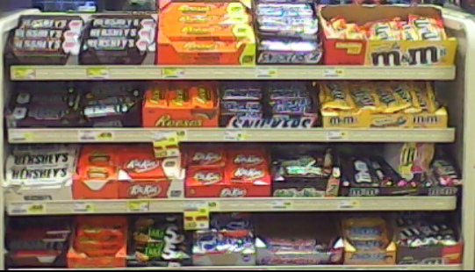
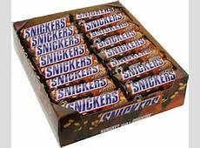
Approach #1: template matching
This method of object detection simply slides the template image over the input image (as in 2D convolution) and compares the template and patch of input image under the template image.
Image
Template
Notes:
BROOKS

Slide 11
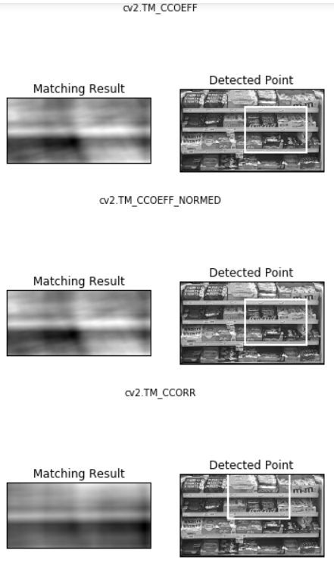
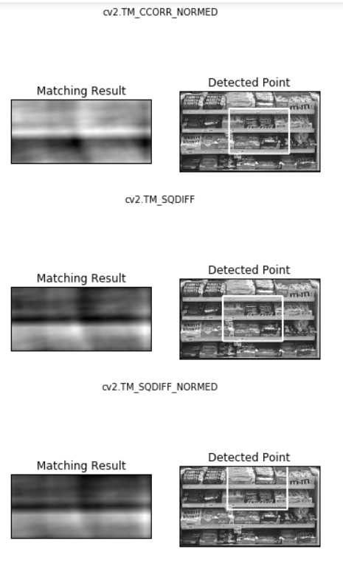
Template matching | example output
Note: “most matched” value is top left of rectangle
We see initial attempt did not do very well
Notes:
BROOKS

Slide 12
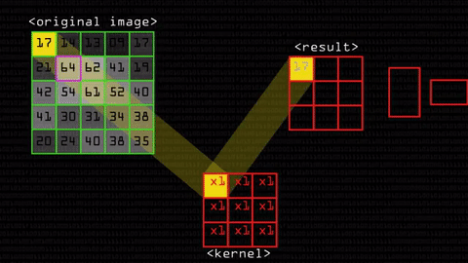
Kernel Convolution
Simple example: Mean Blur Filter
Notes:
SEAN

Slide 13
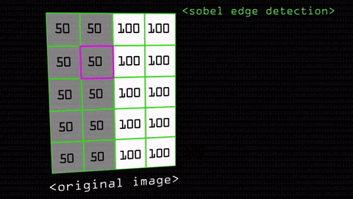
Sobel Edge Detection
Notes:
SEAN

Slide 14
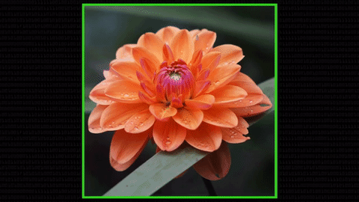
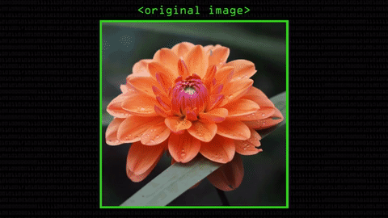
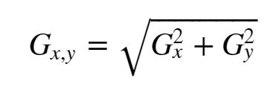
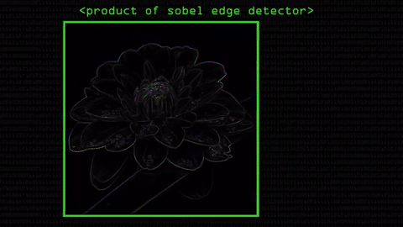
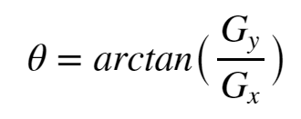
Sobel Edge detection
Notes:
SEAN

Slide 15
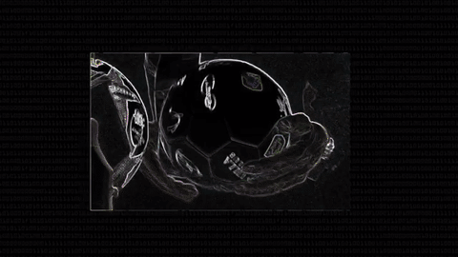
Canny Edge Detection
Step 1: From Sobel output, which has multi-pixel edges, produce the optimal 1 pixel edge
Deduce the direction of the edge from the angle produced by Sobel
Compare multiple potential 1-pixel edges, determine which one has the highest overall Sobel output.
These are local maxima
Notes:
SEAN

Slide 16
Canny edge detection
Step 2: Remove Noise
From the current edges, all are local maxima, however some are much stronger than others
The goal is to only keep the dominant edges and ignore weak, stand-alone edges that can most likely be attributed to noise
Example: In analyzing an unopened snickers bar, the goal of the algorithm would be to keep the edge signifying the outline of the wrapper and ignore the edges caused by glare or reflections in the wrapper
Solution: Hysteresis Thresholding
Notes:
SEAN

Slide 17
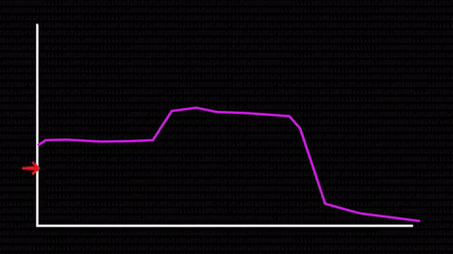
Canny Edge Detection | Hysteresis thresholding
Any edge with Sobel output above upper threshold is automatically included
Any edge with Sobel output below lower threshold is automatically excluded
Any edge with Sobel output between the thresholds that touches an edge in the upper threshold is included
Any edge with Sobel output below upper threshold that does not touch an edge in the upper threshold is excluded
Notes:
SEAN

Slide 18
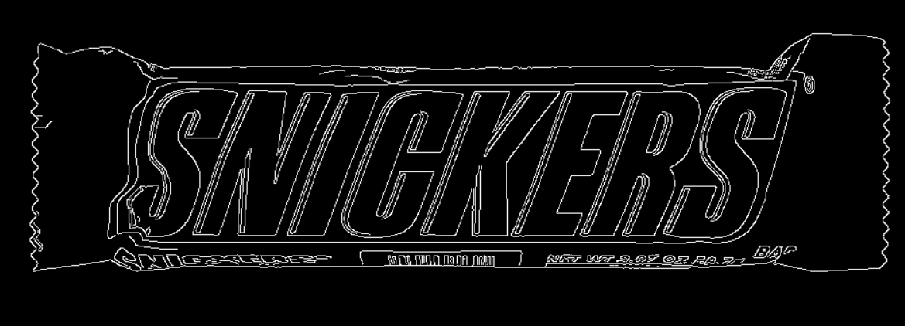
Sobel and Canny edge detection
Note: By adjusting min and max Hysteresis Thresholds, we can control which edges are included
Notes:
SEAN

Slide 19
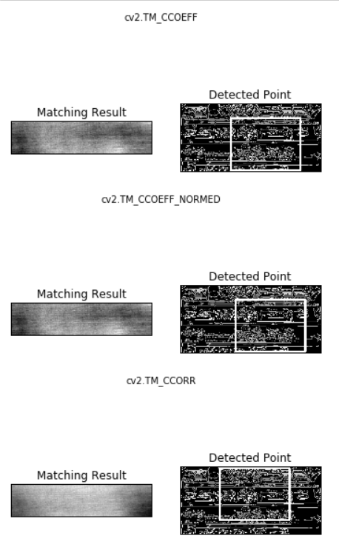
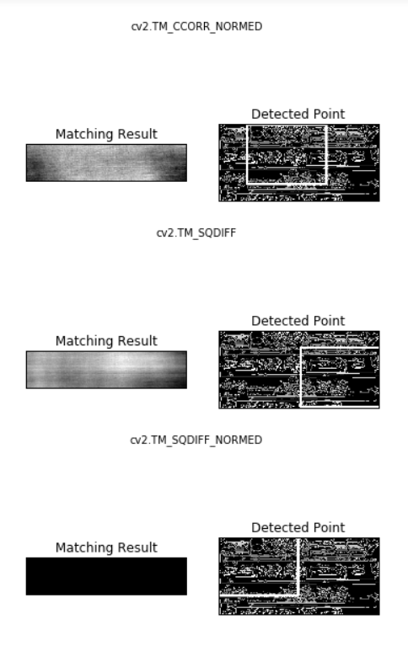
Template matching | example output with edges
Sobel and Canny edge detectors were applied to the images
Just as before, template matching proved to be problematic
The issue most likely has to do with many logos being either partially covered up, tilted in both θ and φ directions, or occasionally too far away for the camera’s resolution or focus
Notes:
SEAN

Slide 20
issues with template matching
Template Matching is NOT scale-invariant or rotation-invariant
Susceptible to different scale of images and non-affine transformations of image
Template matching only works for detecting single instance of the template
Very difficult to overcome this issue
We attempted further tests with template matching in an effort to overcome these issues
Notes:
DAVIS

Slide 21
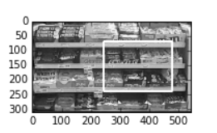
Pseudo-scale-invariance
Used multi-scaling template matching in a cheap workaround to fix the scale-invariance problem
Just continually shrunk the original image until found best match and used this match to draw our rectangle
Still did not perform as well as we wanted
Notes:
DAVIS

Slide 22
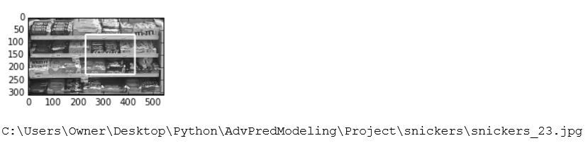
Pseudo-rotation-invariance
Dealt with rotation problem by having folder with many different pics of snickers of different rotations and iterating through this folder to find best match
Similarly poor performance, even when using edge detection
Could have tried artificially rotating single image, but instead just decided to move on to more powerful object detection algorithm
Notes:
DAVIS

Slide 23
ORB (Oriented-FASt and rotated-brief) algorithm
Efficient alternative to SIFT or SURF
Algorithm is not patented (made by OpenCV Labs)
Basically a fusion of FAST key-point detector and BRIEF descriptor with many modifications to enhance the performance.
Importantly, algorithm is scale-invariant and rotation-invariant
Disadvantage:
Uses pyramid scheme to deal with scale BUT
Keypoint scale from depth cues not explored
Not as robust to scale of image as we would like
Notes:
DAVIS

Slide 24
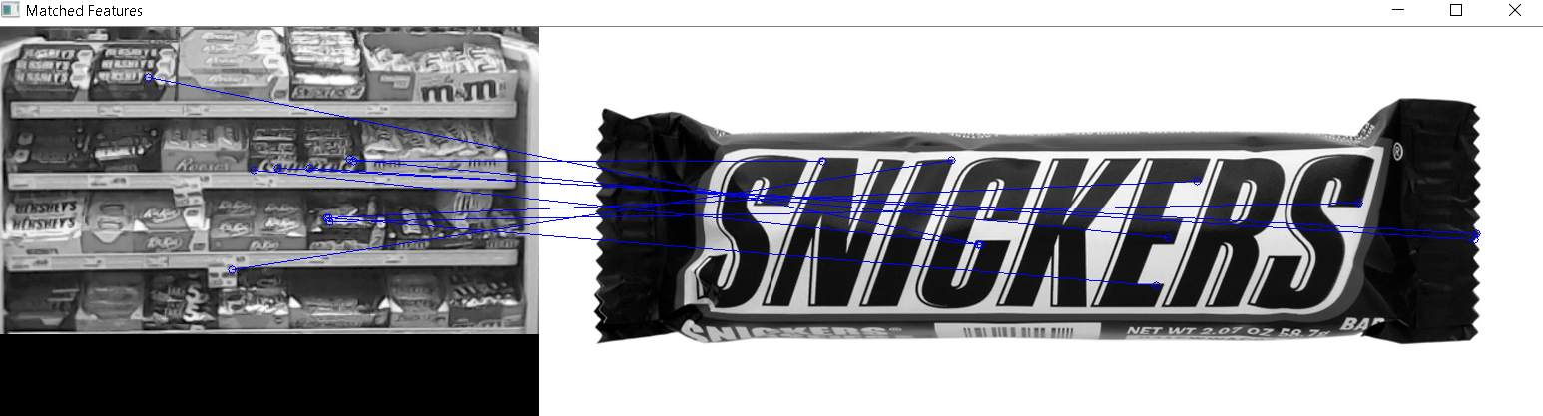
Example of using ORB for feature matching
Blue lines are matched “key-point” features of pic to the image
This is only showing first 10 matches (the “most matching” points)
Brute force matcher used with hamming distance
We see the most matches occur on the snickers box as we want
Could find area of interest by looking at where the mode of the (x, y) coordinates fall
Notes:
DAVIS

Slide 25
Template/Feature Matching | Findings
We found that template/feature matching is not ideal for the problem we are trying to solve
Difficult to find template that could be applied universally to different images
In addition to images from the web, we attempted to use cropped segments of our rack images
Several SKUs have very similar features, making it difficult to discern between them
Poor image resolution and covered/tilted SKU logos make it difficult to apply edge detection
We decided to shift our focus to a different approach
Notes:
DAVIS

Slide 26
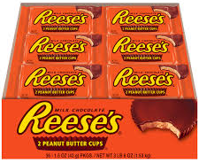
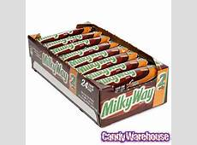
Approach #2: Deep Learning
Training Images
Convolutional Neural Network
Output
Feature
Detection Layers
Feature Classification Layers
Reese’s
Reese’s
Milky Way
Reese’s
Milk Way
Rack Images (i.e. Test Images)
Notes:
DALLAS

Slide 27

Deep Learning | software Comparison
Torch
Native Windows Support
Large repository of code & research papers
TensorFlow
C++ & Python
No native Windows support
Difficult to setup & use
No GPU support on Windows
C++ based w/ Python wrapper
Easy to use
Developed at Berkeley in 2013
Developed by Google Brain Team
Released 2015
Rapidly growing in popularity
Developed at Université de Montréal
Released 2010(?)
Written in Python
Windows support
Relatively slow
Caffe
Developed by Facebook AI & Google DeepMind in 2002
Written in MATLAB/Lua
No native Windows support
Theano
More Information: https://github.com/zer0n/deepframeworks
https://en.wikipedia.org/wiki/Comparison_of_deep_learning_software
Notes:
DALLAS

Slide 28
Deep Learning | Tool Selection
Caffe
Developed at Berkeley in 2013
Native Windows Support
Large repository of code & research papers
C++ based w/ Python wrapper
Difficult to setup & use
Notes:
DALLAS

Slide 29
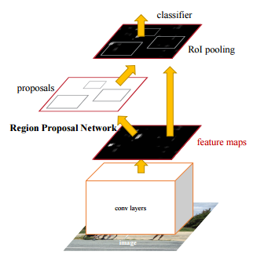
Deep LEARNING | Model Selection
Model: Faster R-CNN
Authors: Shaoqing Ren, Kaiming He, Ross Girshick, Jian Sun
Performs region proposal (i.e. object detection) and object classification in a single, linked convolutional neural network.
Information is shared between region proposal & classification layers, greatly increasing run-time to near real-time (i.e. Production-ready system).
Sources: https://arxiv.org/pdf/1506.01497v3.pdf
https://github.com/rbgirshick/py-faster-rcnn
Notes:
DALLAS

Slide 30
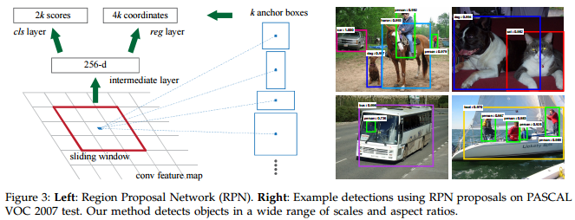
Deep LEARNING | Faster R-CNN
Notes:
DALLAS

Slide 31
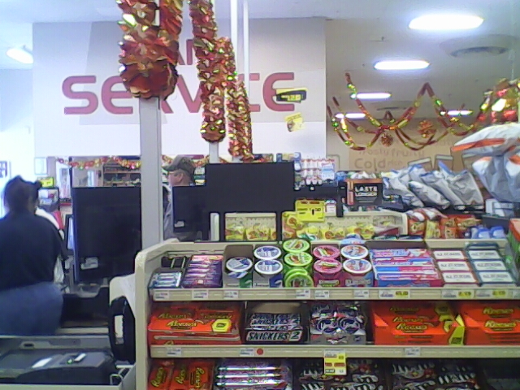
Modeling Challenges
Software issues (deep learning platforms)
Difficult to install
Steep learning curve
Quality of images
Low resolution/blurry
Glare
Image angles and distances
Rack placement varies for different images
Image does not always capture entire rack
Notes:
ZACK

Slide 32
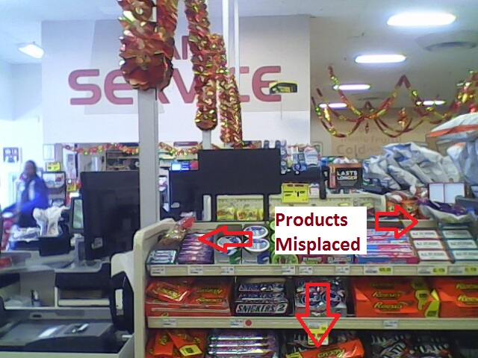
Implementation Challenges
Misplaced products (e.g. Reese’s in a M&M box)
Background noise
Tablet movement/rotation
Changes location/angle of rack in image
Notes:
ZACK

Slide 33
NEXT STEPS
Implement R-CNN for detection & classification of SKUs
Present findings and final model to PopSpots
Enhance algorithm to estimate stock level and evaluate compliance
Notes:
ZACK

Slide 34
Questions
?

Slide 35
Appendix
Paper about ORB: http://www.willowgarage.com/sites/default/files/orb_final.pdf
http://docs.opencv.org/3.0-beta/doc/py_tutorials/py_feature2d/py_orb/py_orb.html
FAST- http://docs.opencv.org/3.0-beta/doc/py_tutorials/py_feature2d/py_fast/py_fast.html
BRIEF - http://www.robots.ox.ac.uk/~vgg/rg/papers/CalonderLSF10.pdf
http://docs.opencv.org/3.1.0/dc/d7d/tutorial_py_brief.html
Animations for Kernel Convolution: https://www.youtube.com/watch?v=C_zFhWdM4ic
Animations for Sobel: https://www.youtube.com/watch?v=uihBwtPIBxM&t=361s
Animations for Canny: https://www.youtube.com/watch?v=sRFM5IEqR2w

